Slide 1


Slide 2
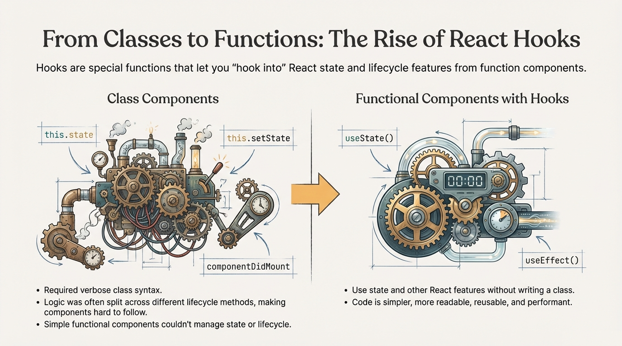
©2025 Rishabh Singh [@itsindrajput]. Feel Free to Share.

Slide 3
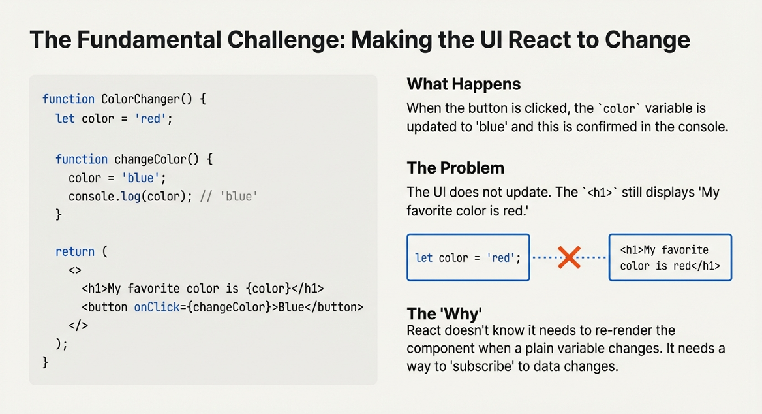
©2025 Rishabh Singh [@itsindrajput]. Feel Free to Share.

Slide 4
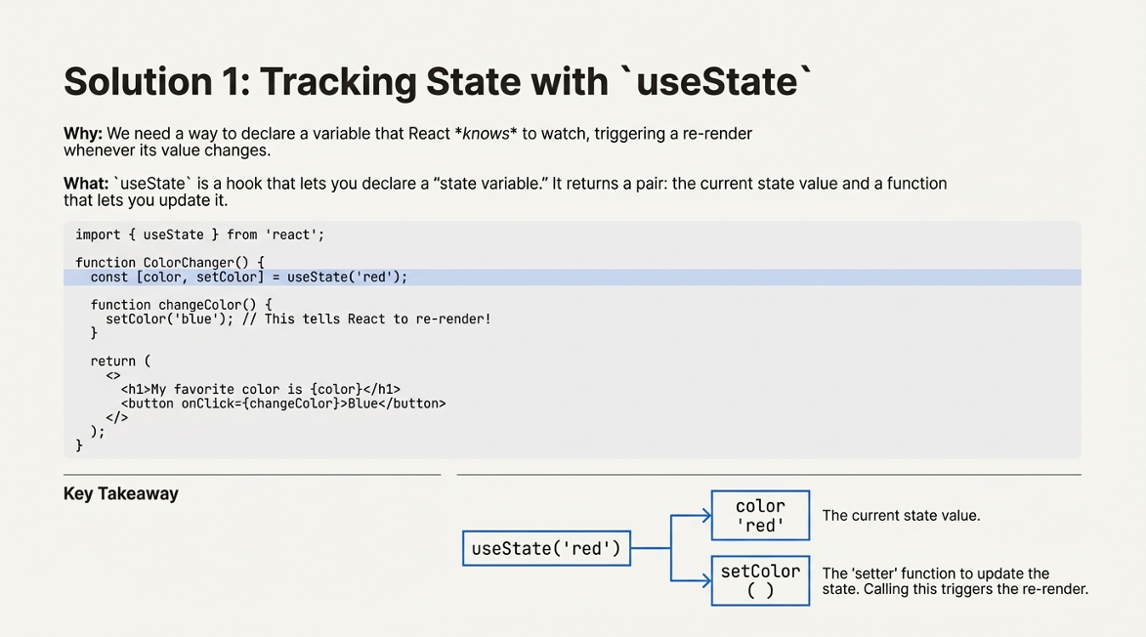
©2025 Rishabh Singh [@itsindrajput]. Feel Free to Share.

Slide 5
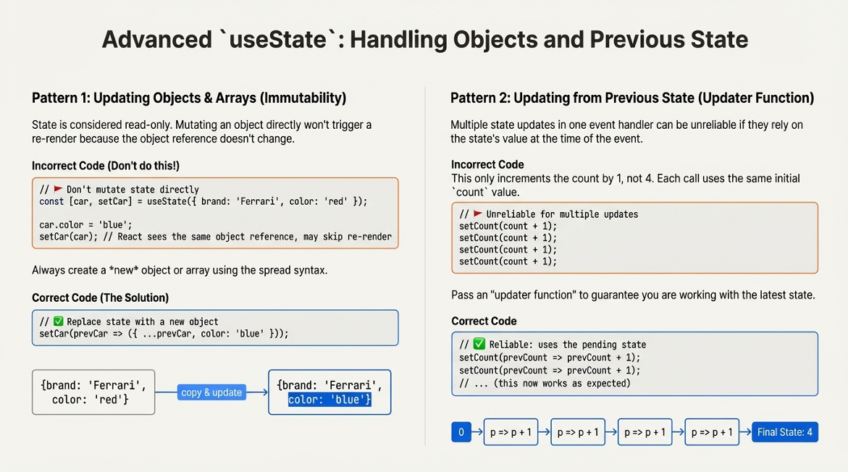
©2025 Rishabh Singh [@itsindrajput]. Feel Free to Share.

Slide 6
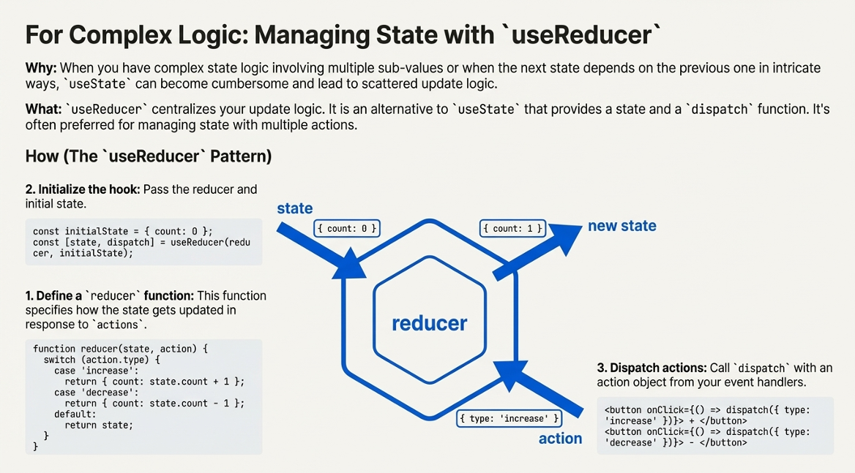
©2025 Rishabh Singh [@itsindrajput]. Feel Free to Share.

Slide 7
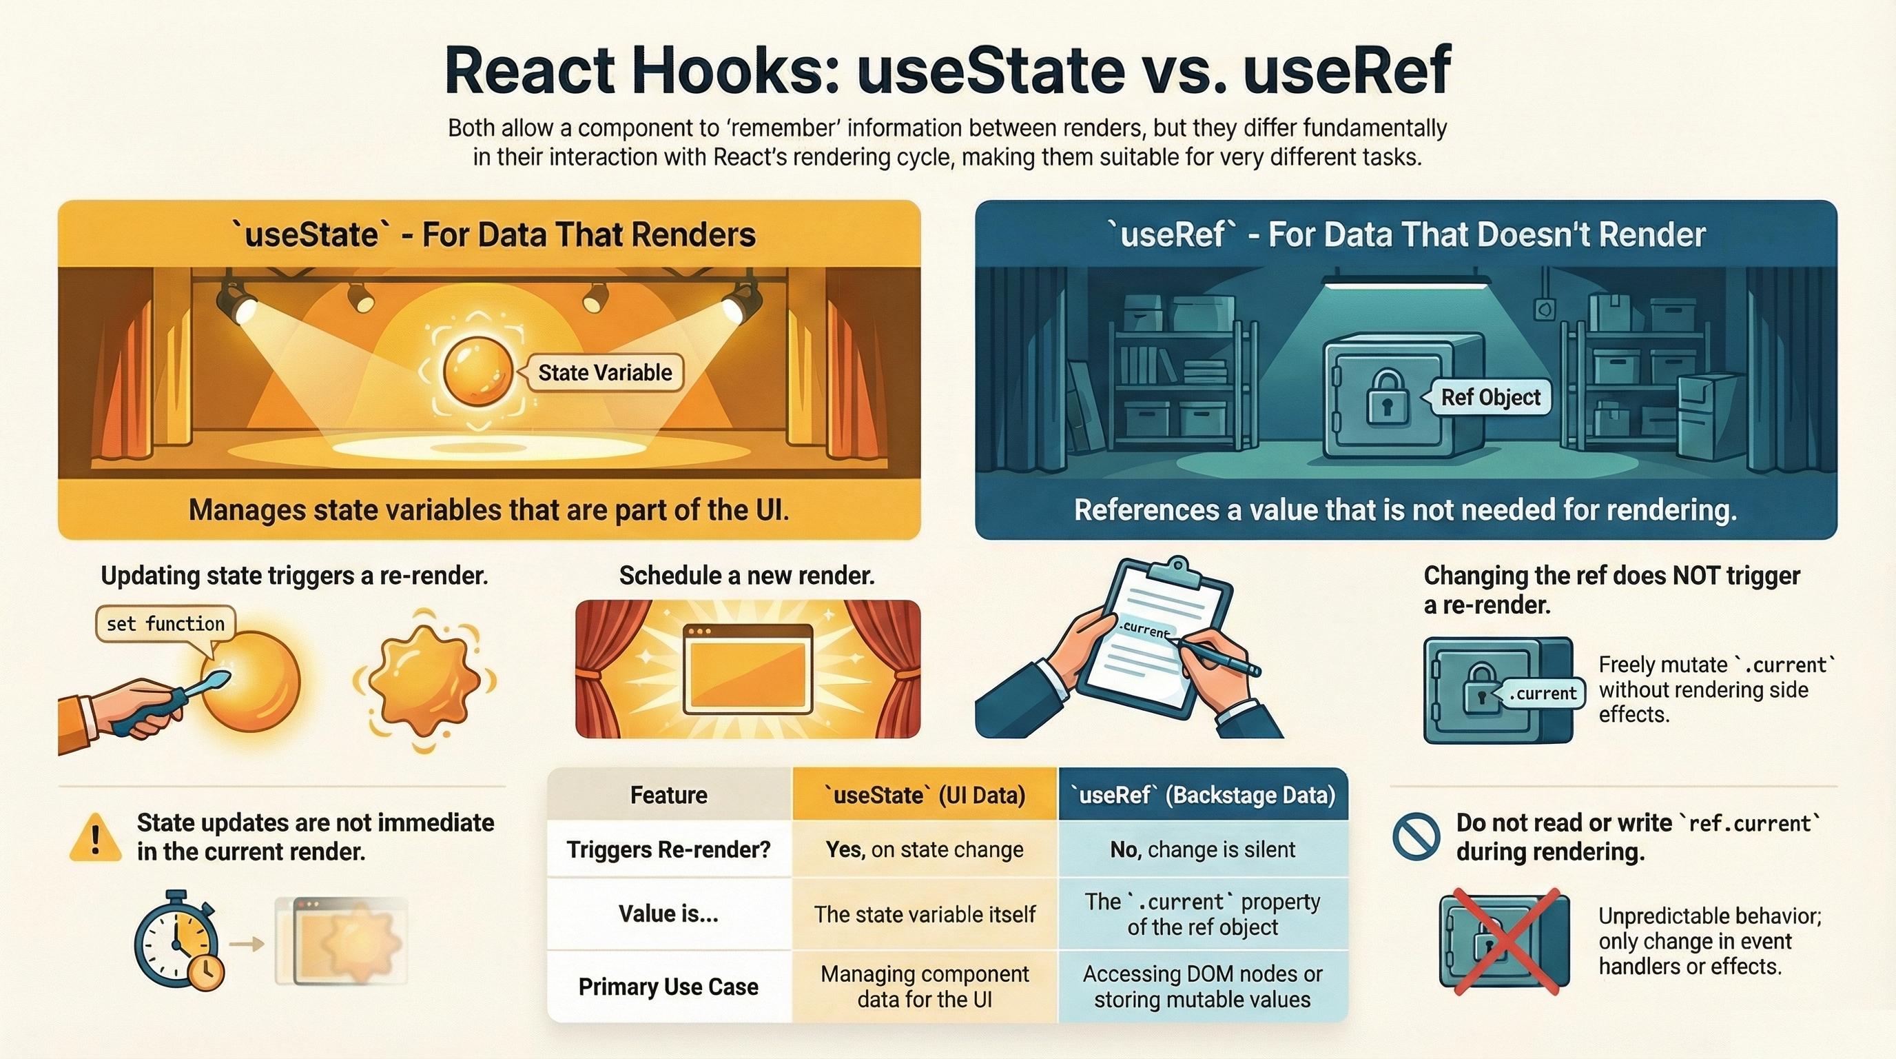

Slide 8
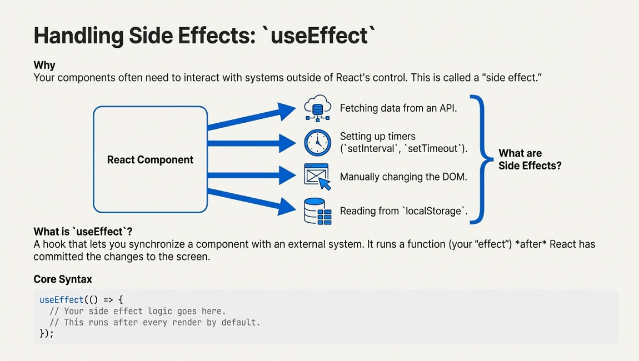
©2025 Rishabh Singh [@itsindrajput]. Feel Free to Share.

Slide 9
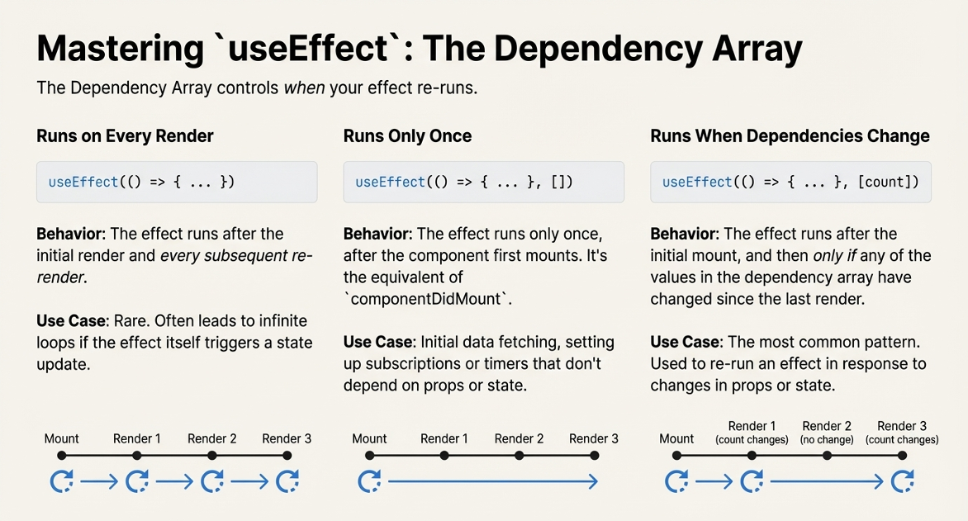
©2025 Rishabh Singh [@itsindrajput]. Feel Free to Share.

Slide 10
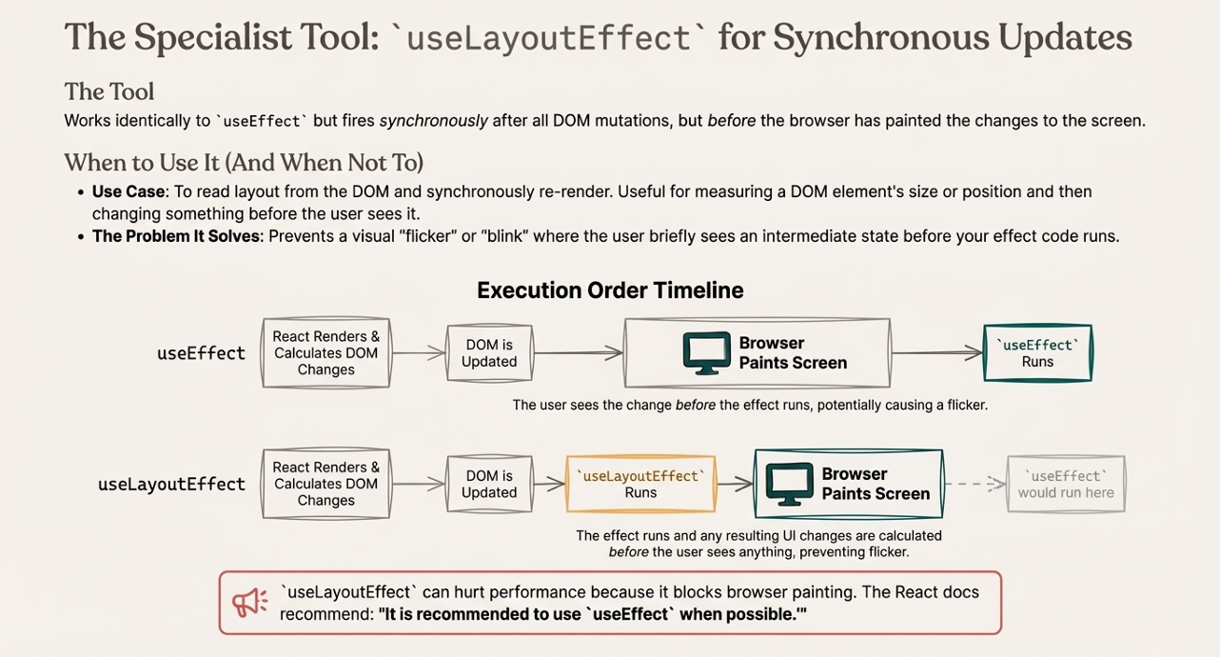

Slide 11
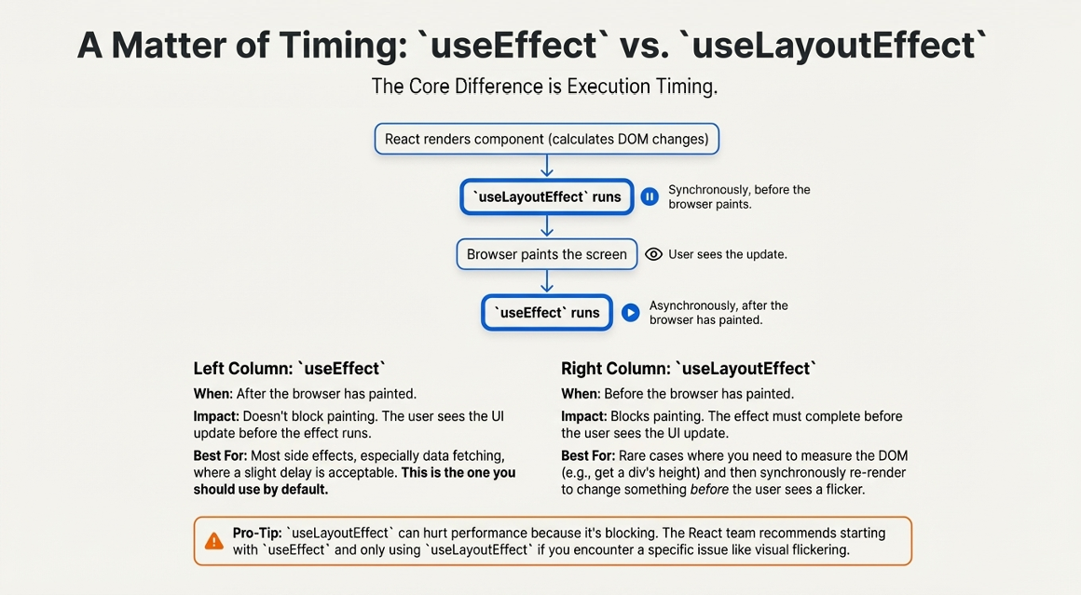
©2025 Rishabh Singh [@itsindrajput]. Feel Free to Share.

Slide 12
Practice useState and useEffect
1. You're building a React component and want to manage a user's profile information, which includes their name, age, occupation and email. If you use a single useState hook to store this information as an object, how should you update only the user's email without losing the existing name and age when the user changes their email in an input field?
2. Imagine you're building a simple status display for an online service. You want to show whether the service is "Online" or "Offline" and update this status every few seconds, simulating a check.
Your task:
Create a React functional component called ServiceStatus. Use useState to manage a status variable, initialized to "Checking...".
Use useEffect to toggle the status between "Online" and "Offline" every 3000 milliseconds (3 seconds). It should start as "Online" after the initial "Checking...". Display the current status in your component.
This will involve using setInterval inside useEffect and clearing it up when the component unmounts to prevent memory leaks (a common and important pattern with useEffect and timers!).
©2025 Rishabh Singh [@itsindrajput]. Feel Free to Share.

Slide 13
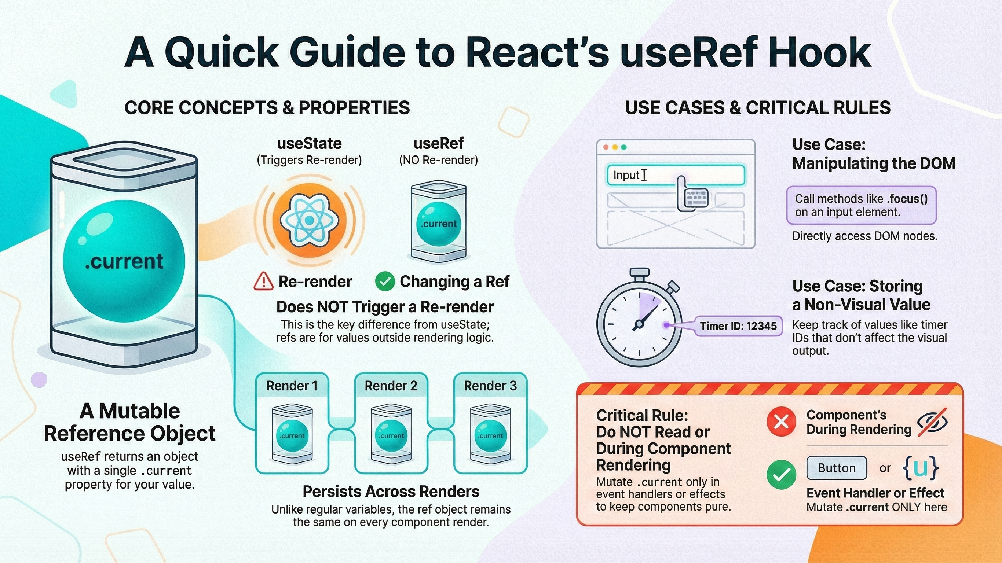
©2025 Rishabh Singh [@itsindrajput]. Feel Free to Share.

Slide 14
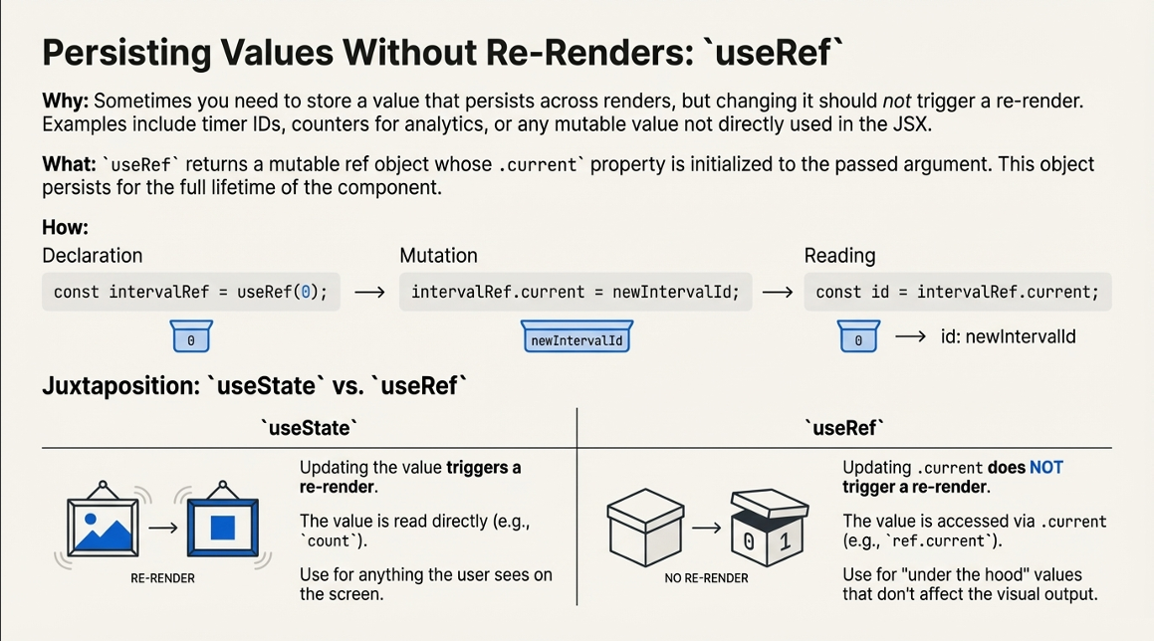
©2025 Rishabh Singh [@itsindrajput]. Feel Free to Share.

Slide 15
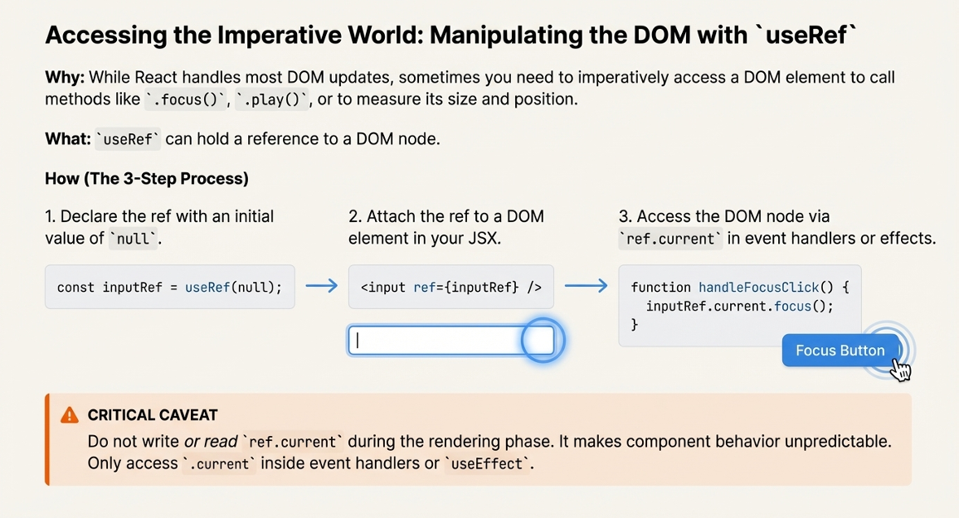
©2025 Rishabh Singh [@itsindrajput]. Feel Free to Share.

Slide 16
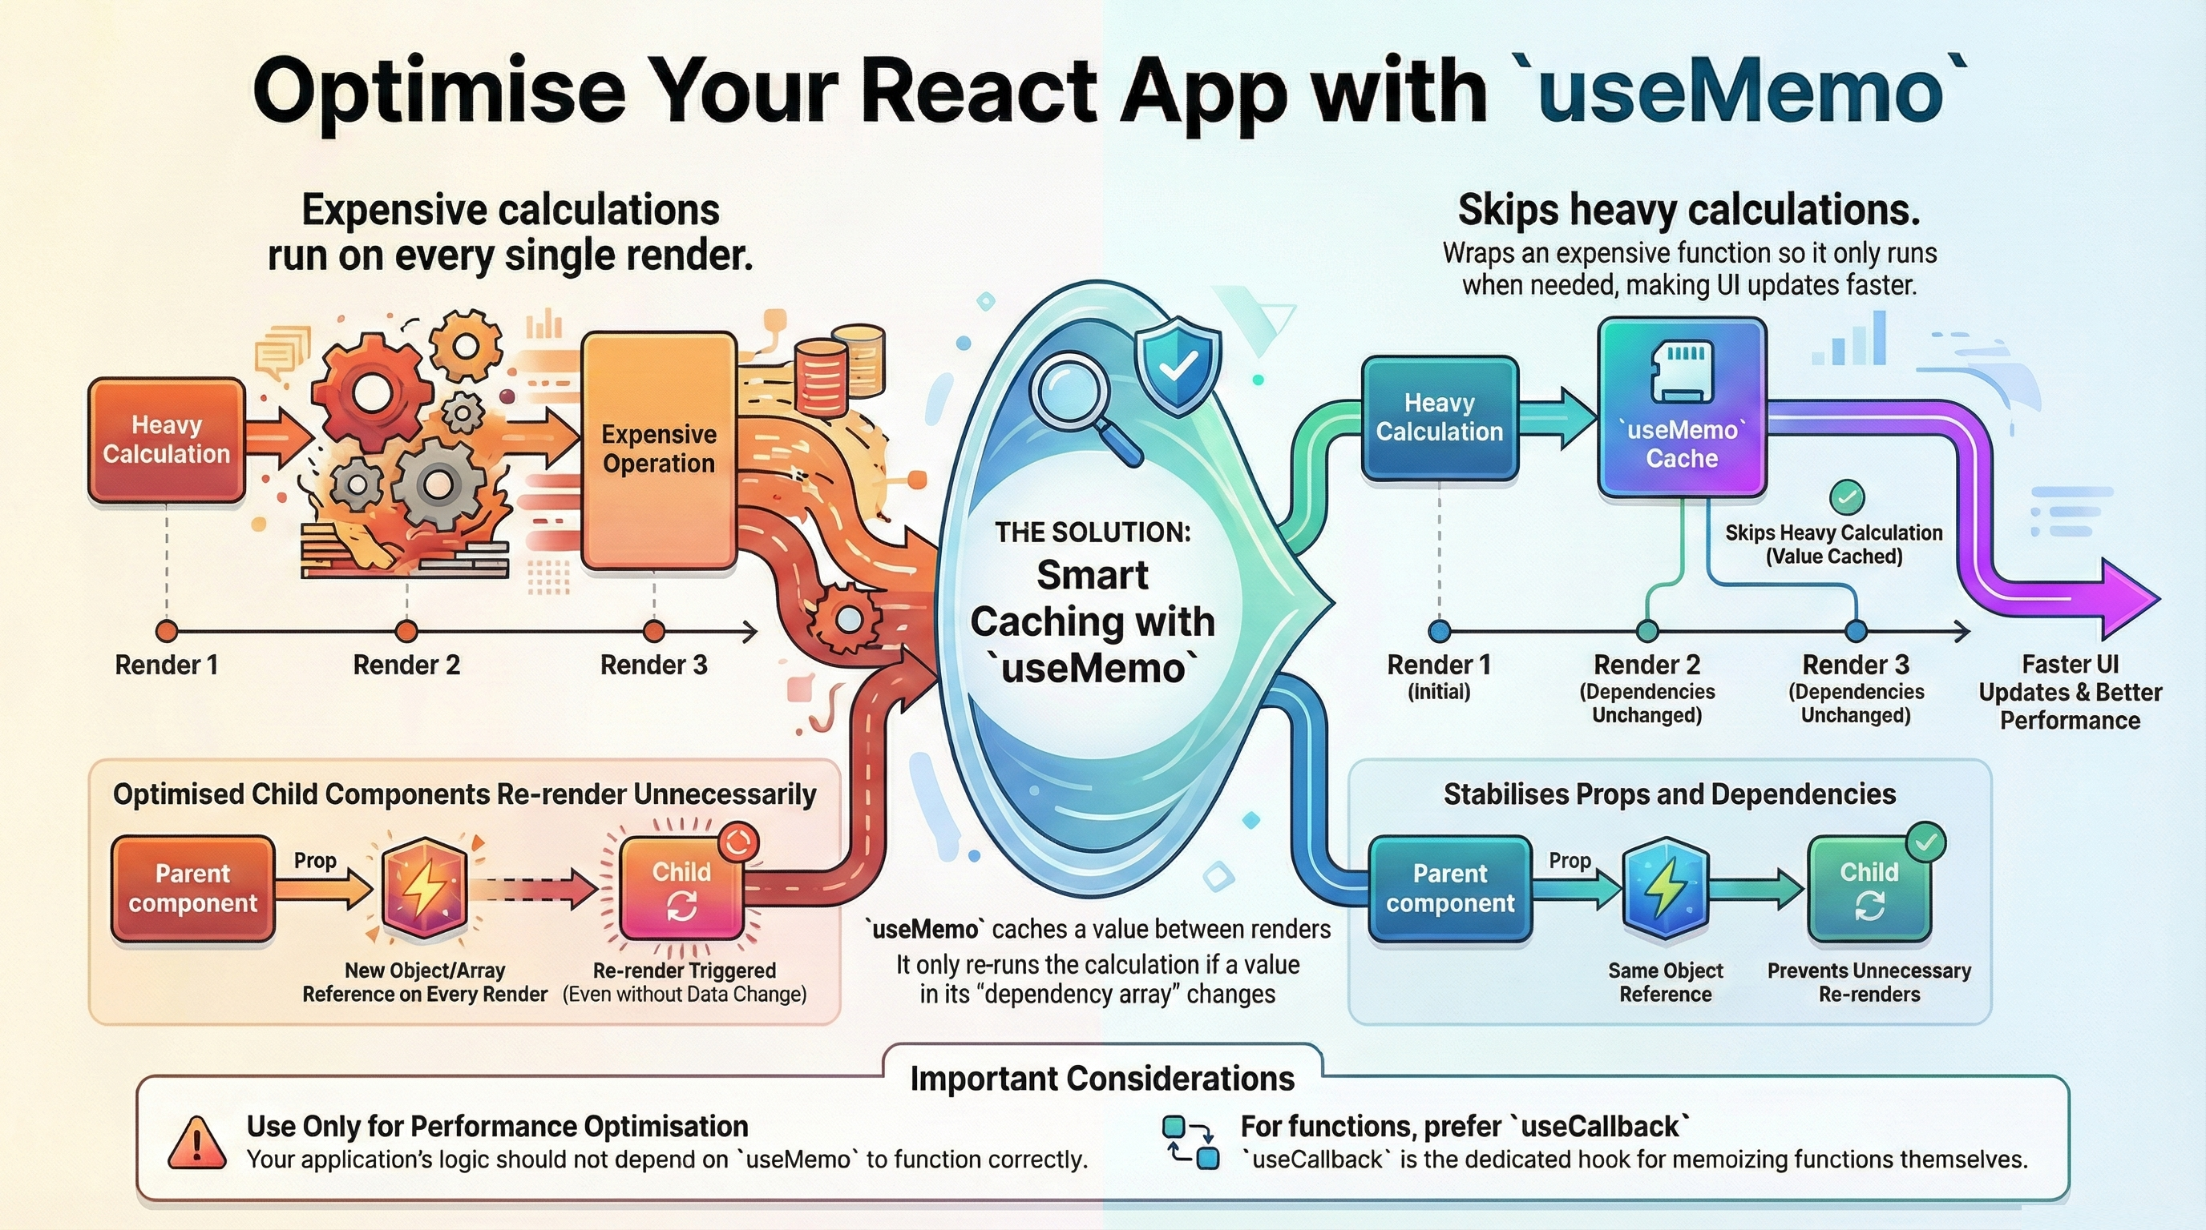

Slide 17
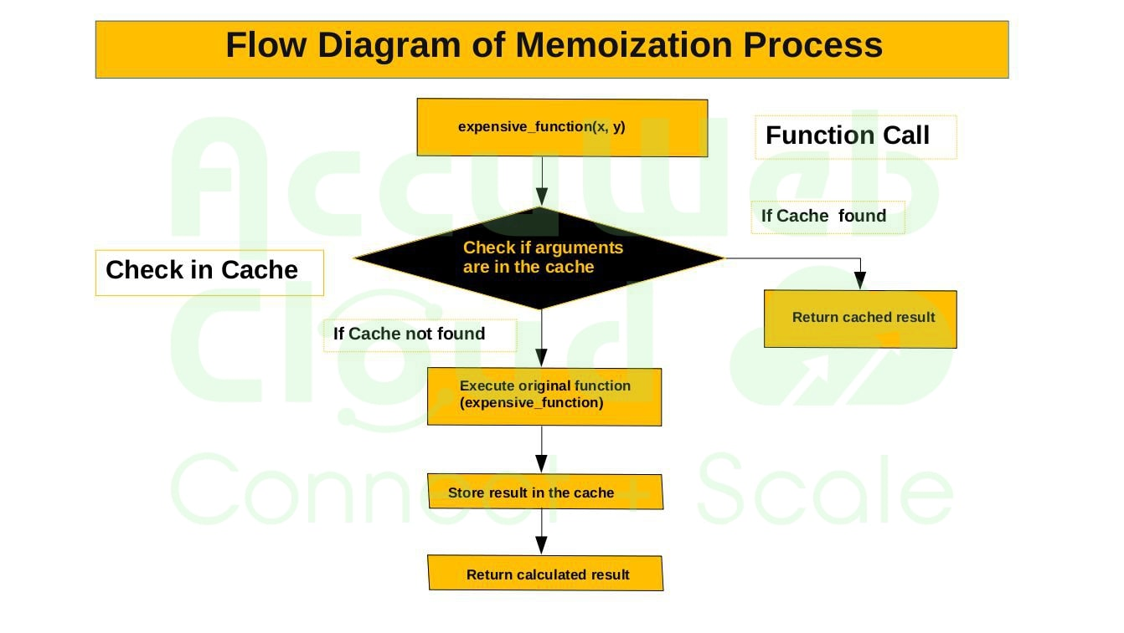
Problem:
When your component re-renders, everything inside it runs again, including heavy calculations.
Solution:
useMemo remembers the result of a calculation.
How it works:
It runs the function ONLY when the dependency changes.
Otherwise, it reuses the old saved value (cached value).
Example from your code:
const result = useMemo(() =>
cubeCalculation(number), [number]);
This means:
If number changes → calculate cube again
If count changes → DO NOT calculate cube again
Saves performance and prevents unnecessary work
Think of useMemo like:
“Don’t calculate again unless it's really needed.”
©2025 Rishabh Singh [@itsindrajput]. Feel Free to Share.

Slide 18
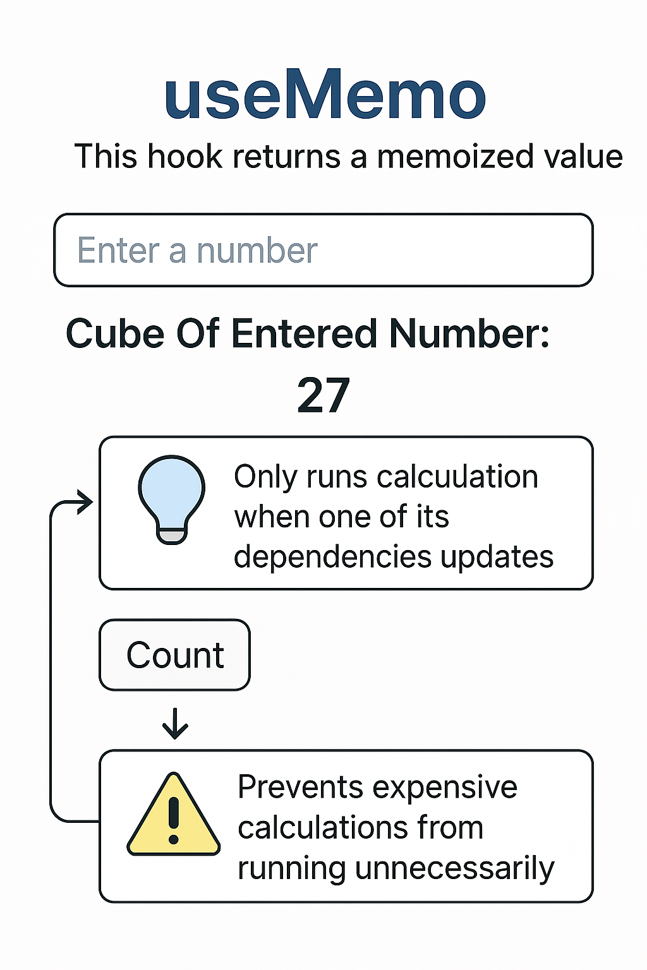
import React, { useMemo, useState } from "react";
export default const UseMemo = () => {
const [number, setNumber] = useState(0);
const [count, setCount] = useState(0);
const cubeCalculation = (num) => {
console.log("Calculating cube...");
return Math.pow(num, 3);
};
// const result = cubeCalculation(number);
const result = useMemo(() => {
return cubeCalculation(number);
}, [number]);
return (
<>
<input type="text“ value={number}
onChange={(e) => setNumber(e.target.value)}
placeholder="Enter a number“ />
<p>Cube Of Entered Number: {result}</p>
<button onClick={() => setCount(count + 1)}>Count</button>
<p>{count}</p>
</>
);};
Example
©2025 Rishabh Singh [@itsindrajput]. Feel Free to Share.

Slide 19


Slide 20
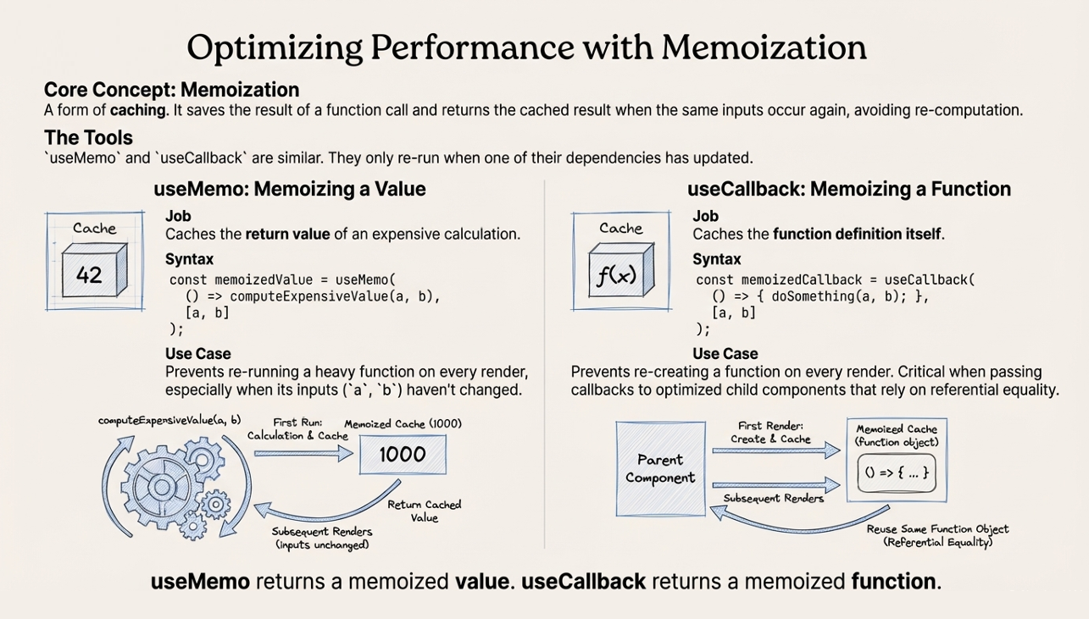

Slide 21
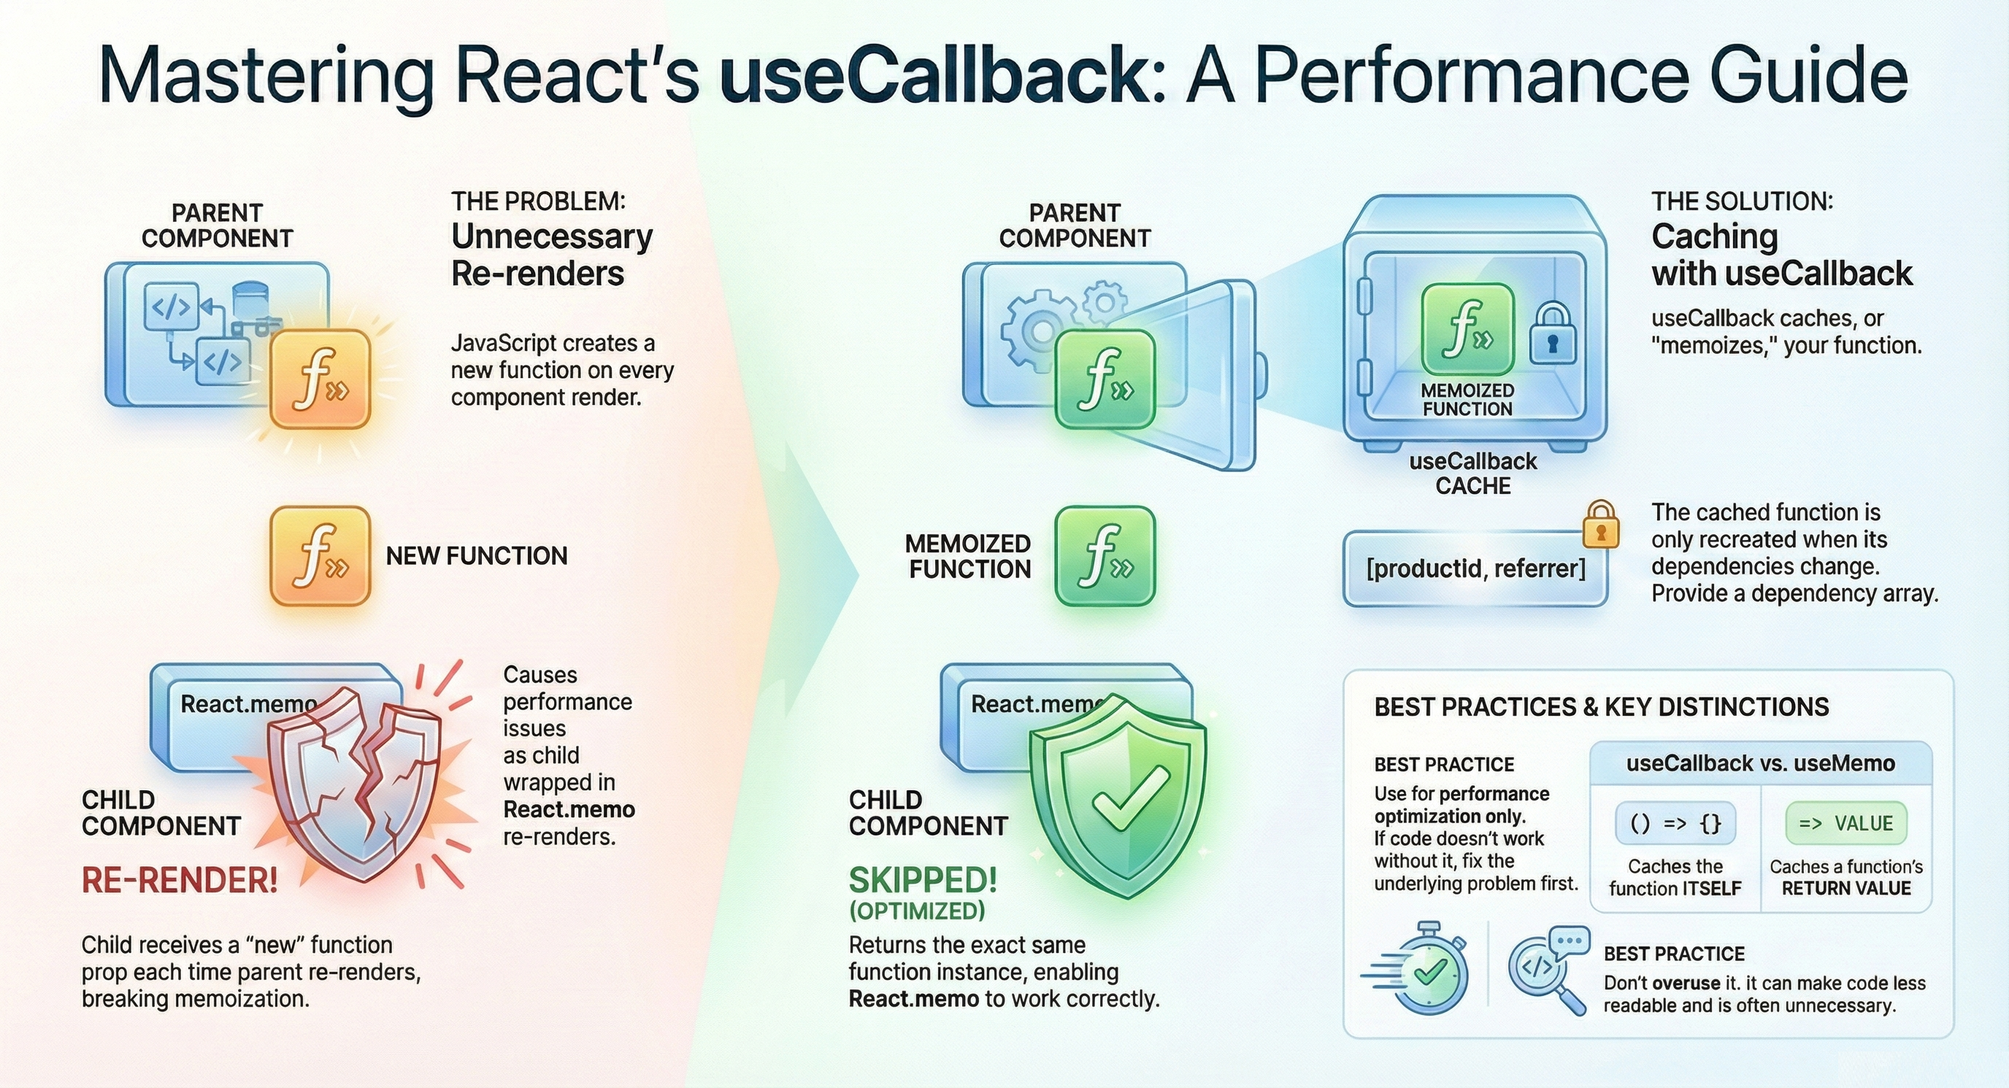
©2025 Rishabh Singh [@itsindrajput]. Feel Free to Share.

Slide 22
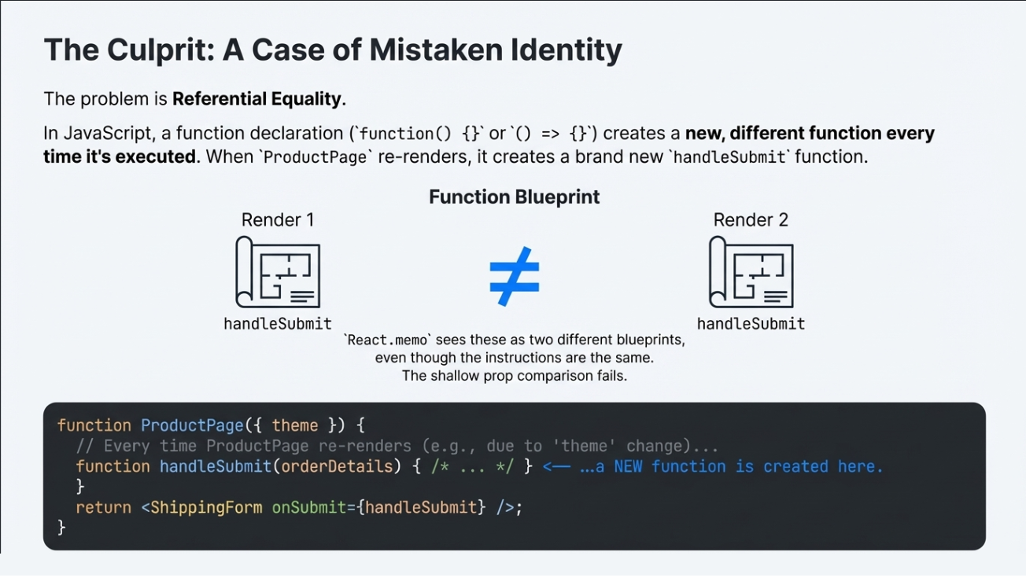
©2025 Rishabh Singh [@itsindrajput]. Feel Free to Share.

Slide 23
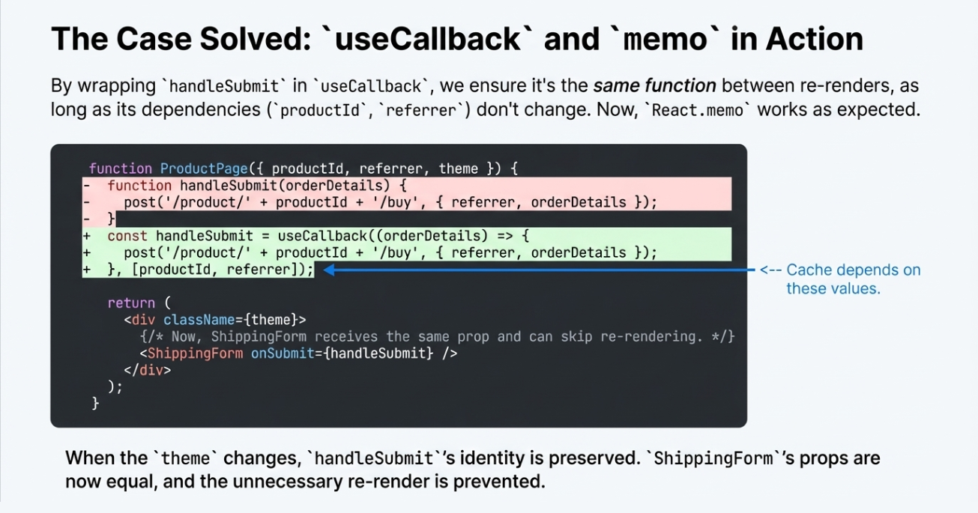

Slide 24
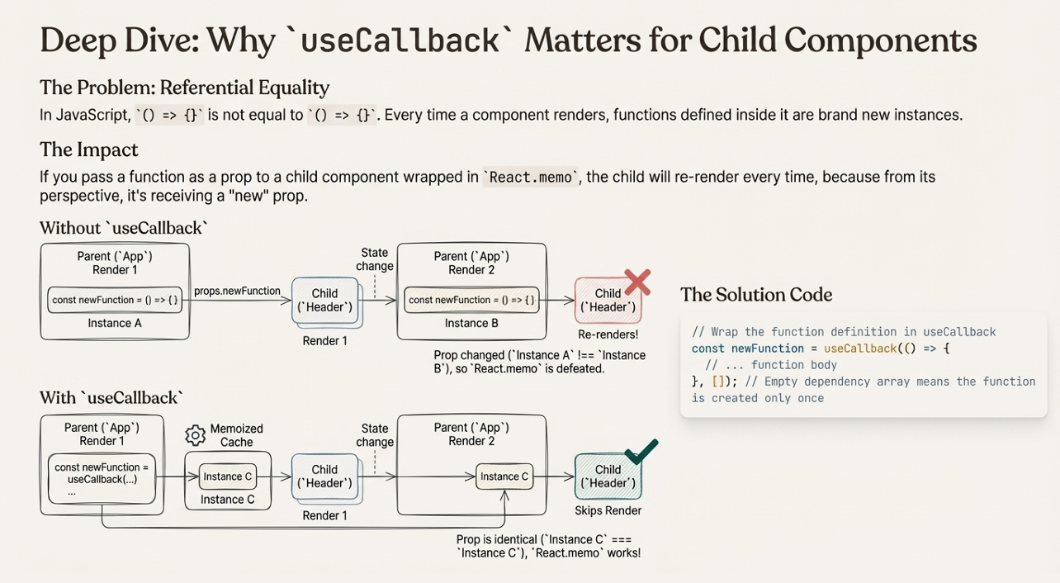

Slide 25
Example
import React, { useCallback, useState } from "react";
import Header from "./Header";
const UseCallback = () => {
const [count, setCount] = useState(0);
// const newFn = () => {};
const newFn = useCallback(() => {}, []);
return (
<div>
<Header newFn={newFn} />
<p>Count: {count}</p>
<button onClick={() => setCount((prev) => prev + 1)}>
Increment Count
</button>
</div>
);
};
export default UseCallback;
useCallback is a React Hook that memoizes (caches) a function so that it does not get recreated on every render — unless its dependencies change.
This is useful when you’re passing functions down to child components that rely on reference equality (e.g., via React.memo), because in React, functions are objects, and a new function reference gets created on every render unless it’s memoized.
©2025 Rishabh Singh [@itsindrajput]. Feel Free to Share.

Slide 26
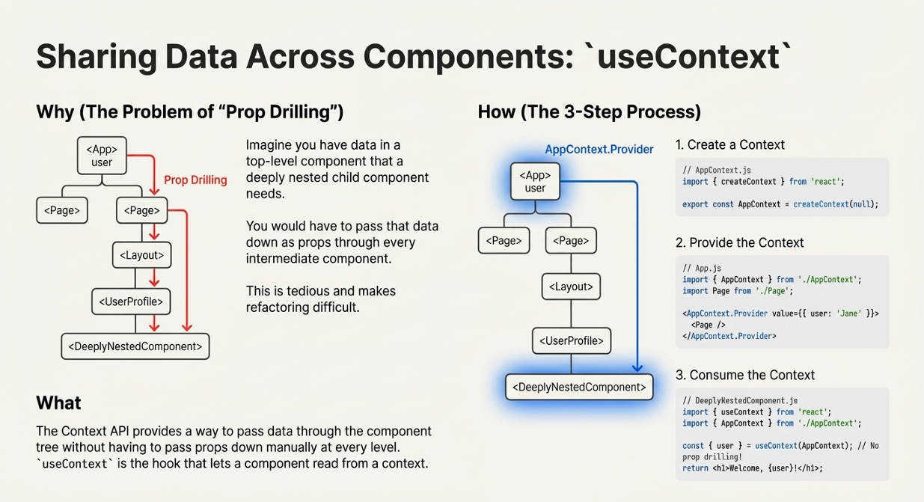
©2025 Rishabh Singh [@itsindrajput]. Feel Free to Share.

Slide 27
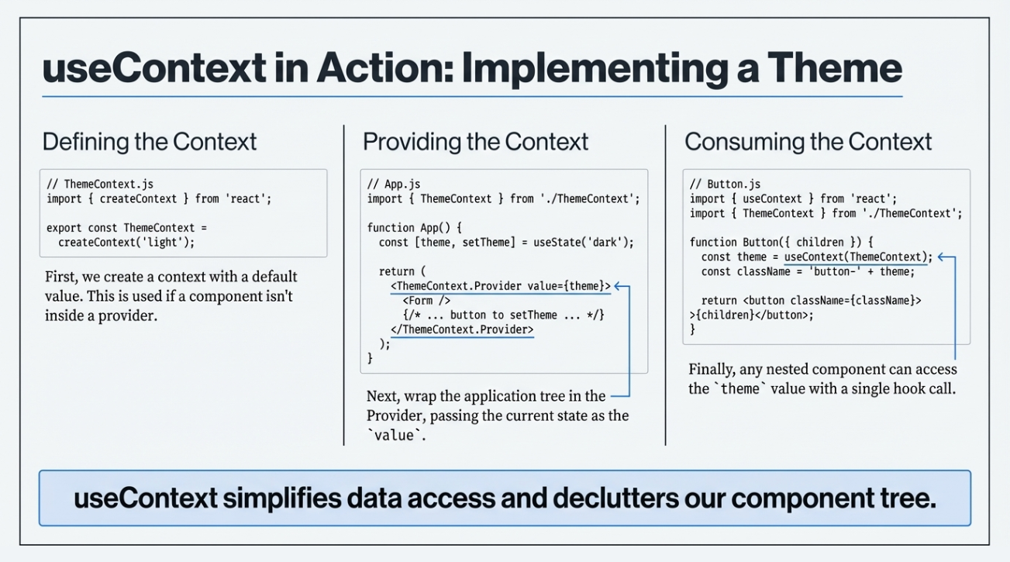

Slide 28
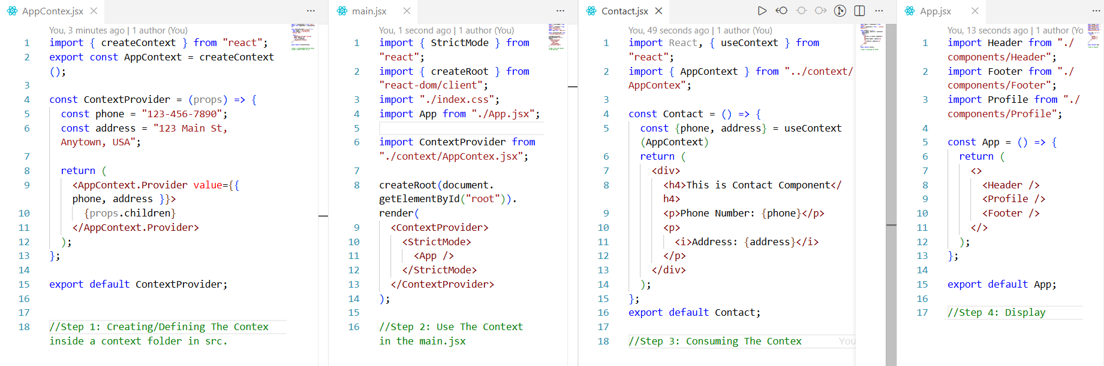
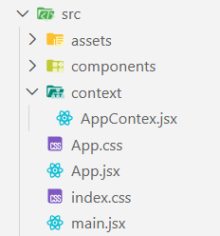
©2025 Rishabh Singh [@itsindrajput]. Feel Free to Share.

Slide 29


Slide 30
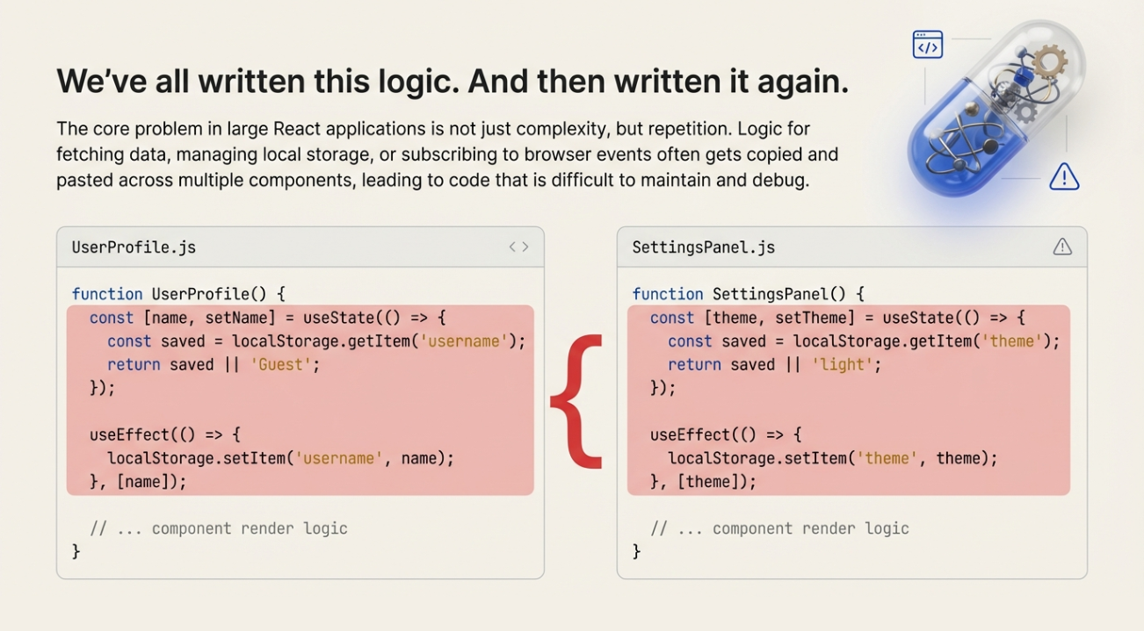
©2025 Rishabh Singh [@itsindrajput]. Feel Free to Share.

Slide 31
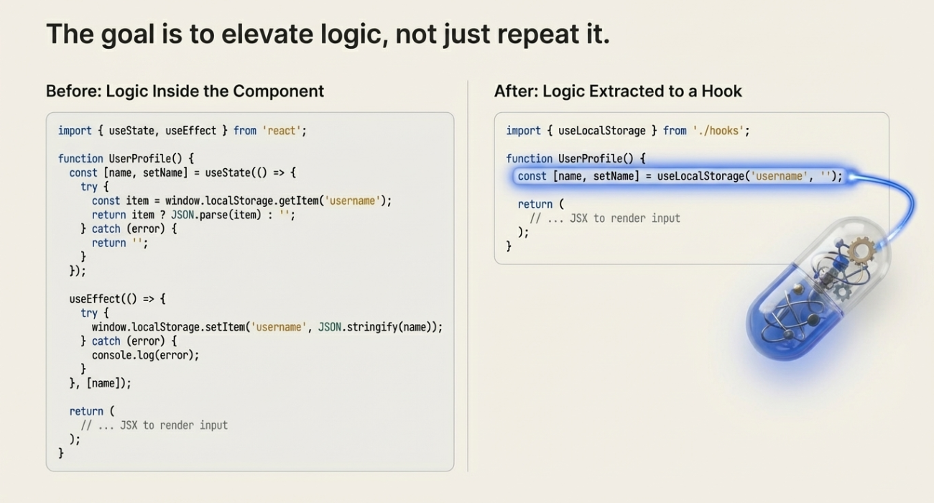
©2025 Rishabh Singh [@itsindrajput]. Feel Free to Share.

Slide 32
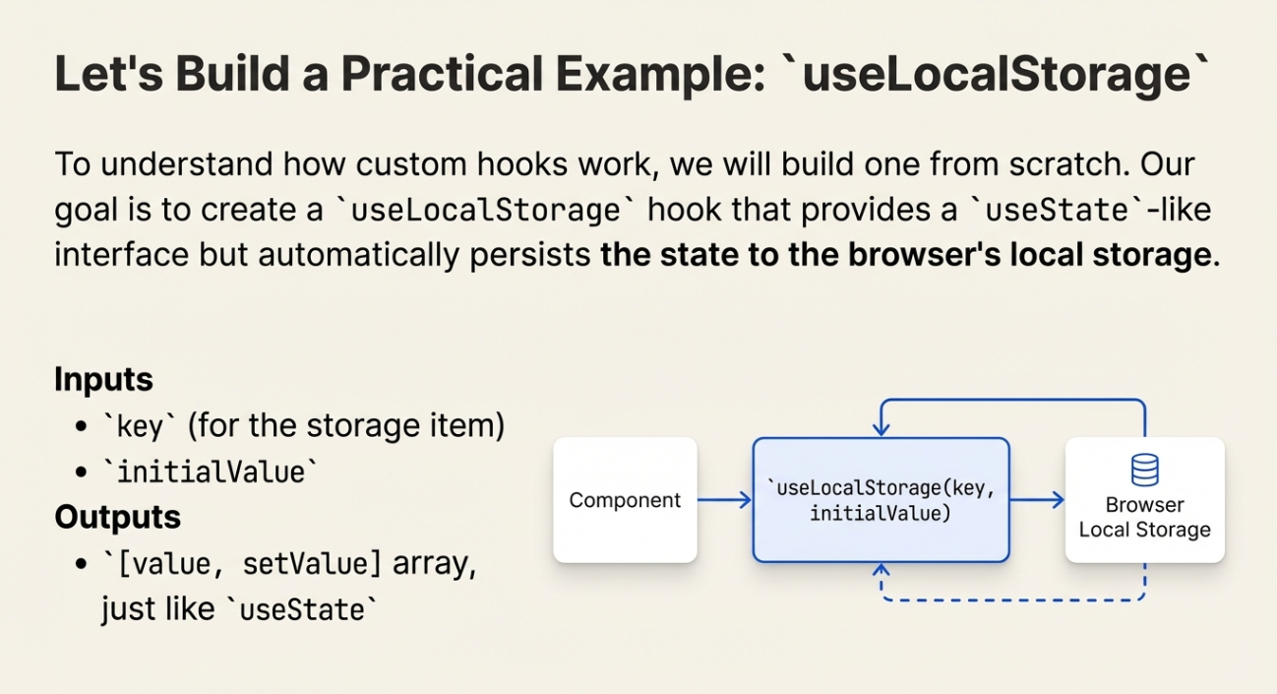
©2025 Rishabh Singh [@itsindrajput]. Feel Free to Share.

Slide 33
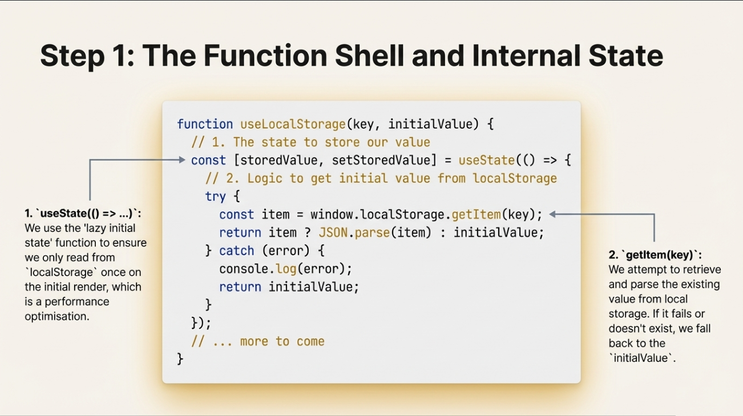
©2025 Rishabh Singh [@itsindrajput]. Feel Free to Share.

Slide 34
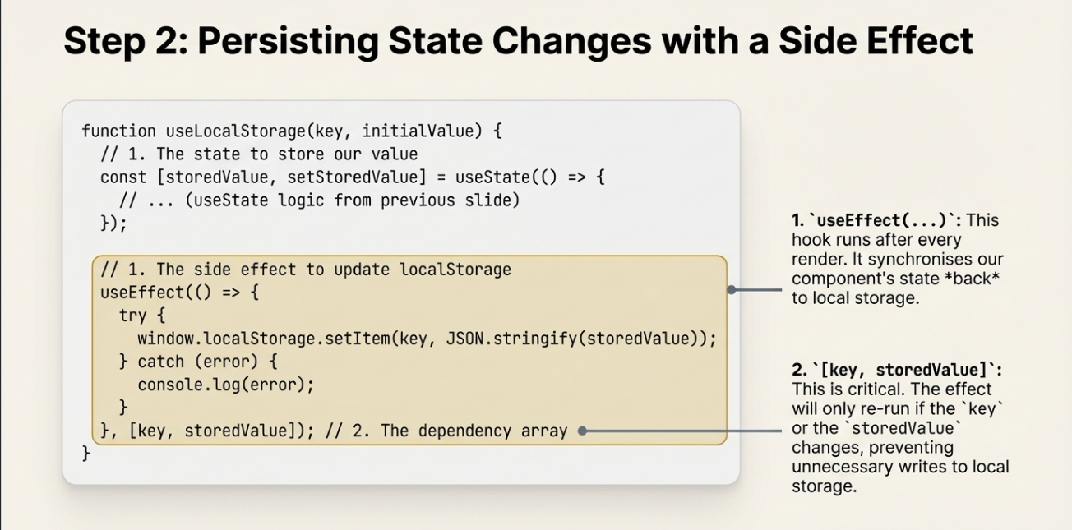
©2025 Rishabh Singh [@itsindrajput]. Feel Free to Share.

Slide 35
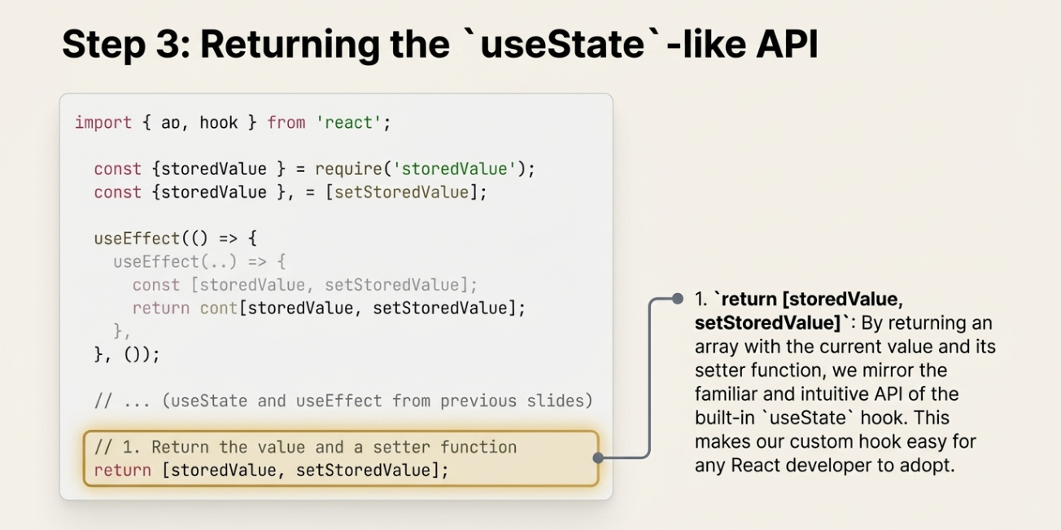
©2025 Rishabh Singh [@itsindrajput]. Feel Free to Share.

Slide 36
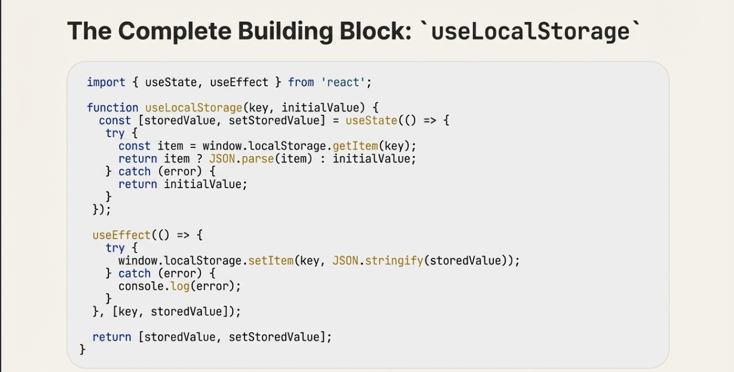
©2025 Rishabh Singh [@itsindrajput]. Feel Free to Share.

Slide 37
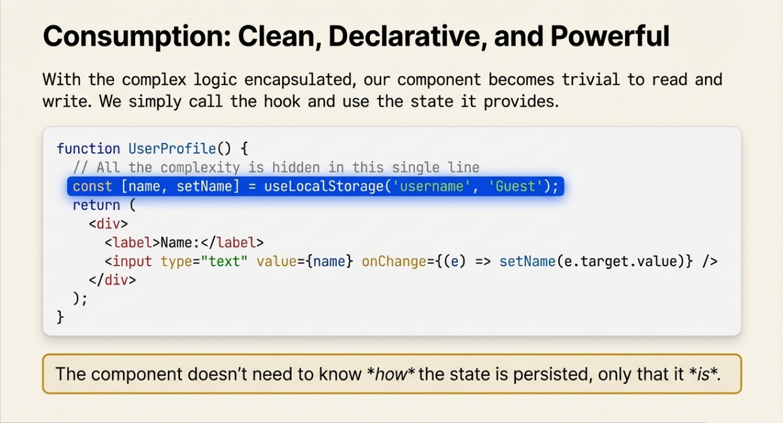
©2025 Rishabh Singh [@itsindrajput]. Feel Free to Share.

Slide 38
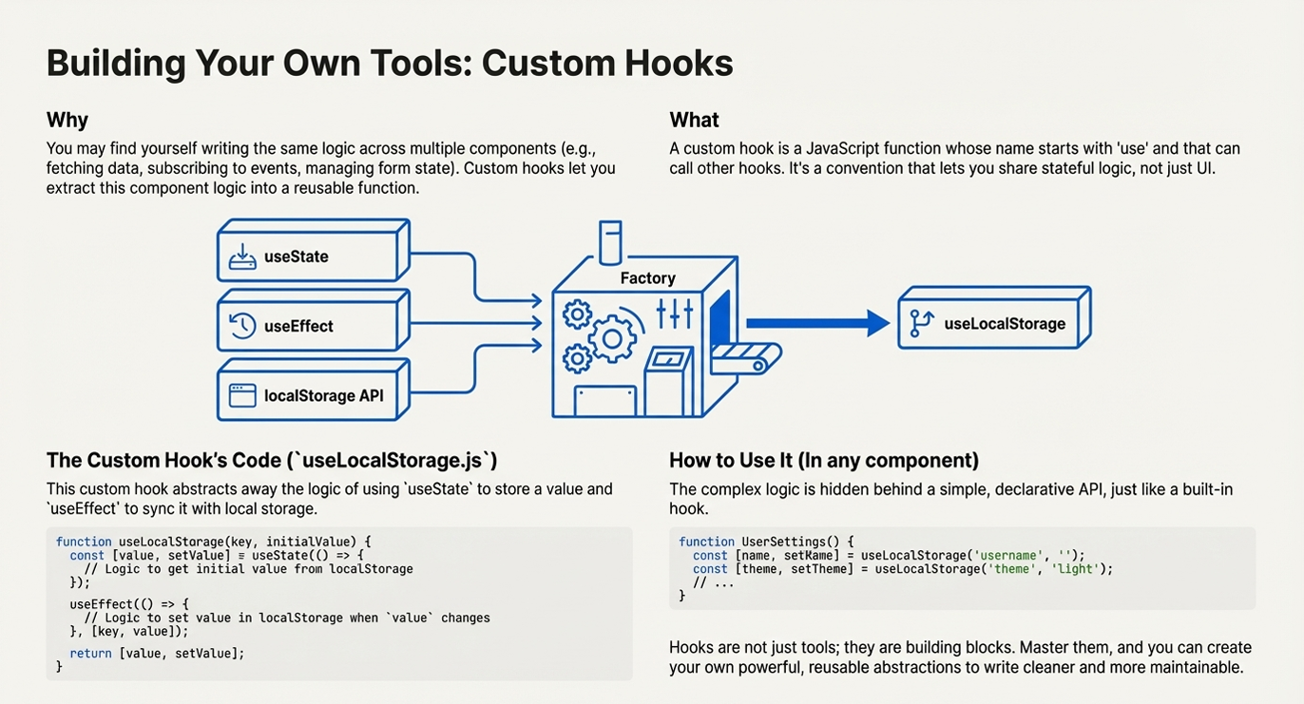

Slide 39
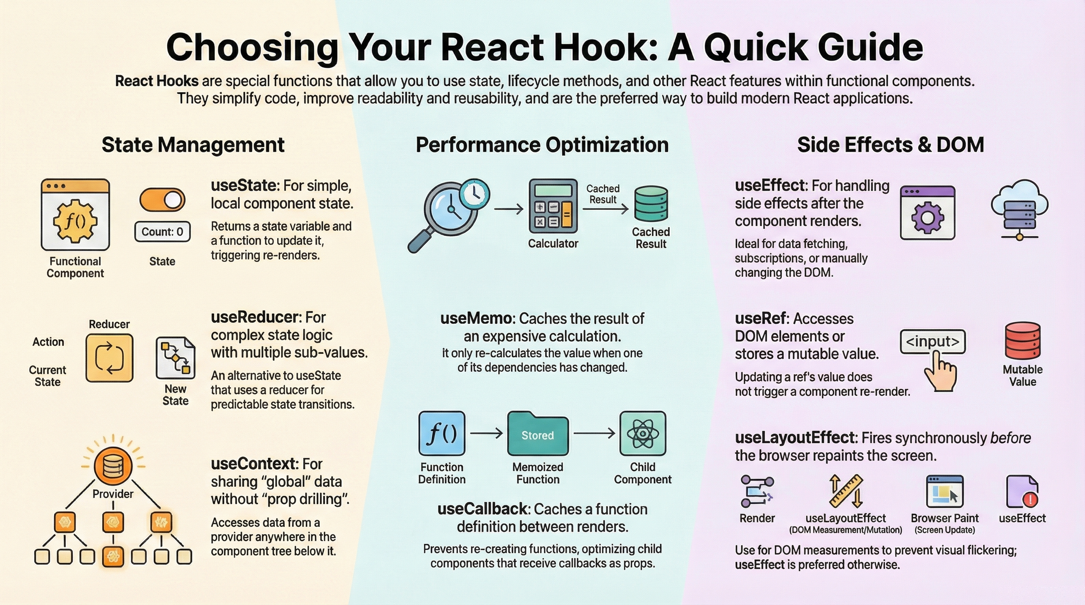
©2025 Rishabh Singh [@itsindrajput]. Feel Free to Share.

Slide 40
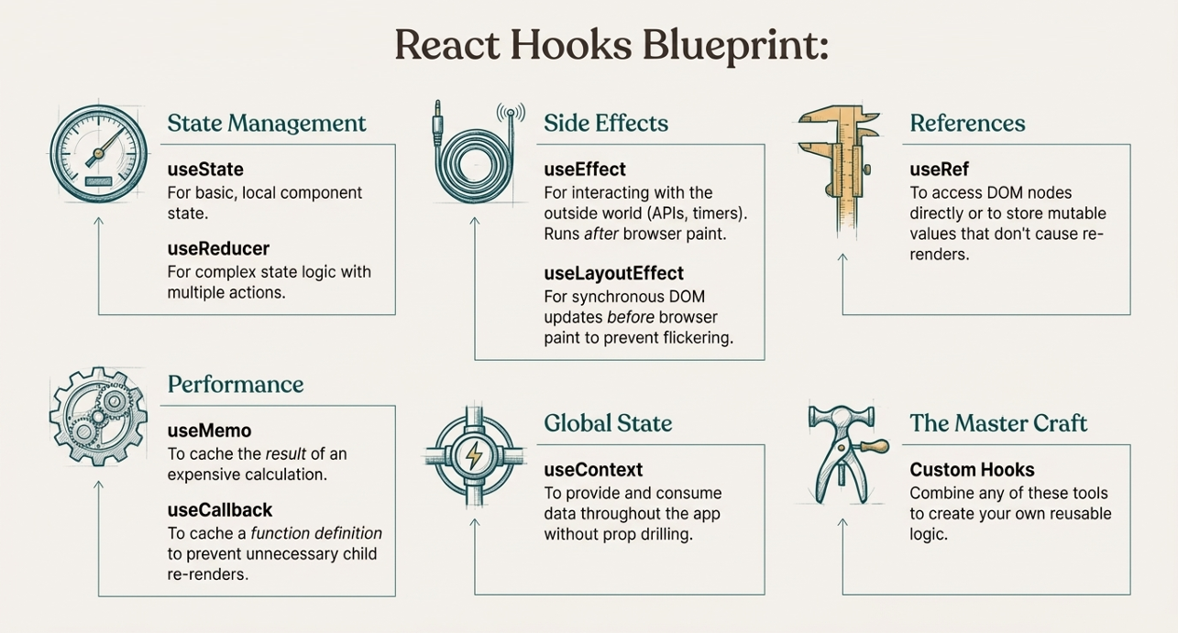
©2025 Rishabh Singh [@itsindrajput]. Feel Free to Share.

Slide 41
🎉 Thanks for Reaching Till the End!
Your journey into React Hooks doesn't stop here. Keep learning, keep building!
🔗 Connect With Me
🌐 Portfolio 💼 LinkedIn 🐦 Twitter (X) 💻 GitHub
📘 Source Code for This Hooks Presentation
👉 GitHub Repo: https://github.com/itsindrajput/ReactProjects/tree/main/Hooks
Your time and attention mean a lot. If you found this helpful, feel free to share or reach out —Let’s build and learn together! 🚀

